Slide 1

How to Use Microsoft PowerPoint 2007

Slide 2
What is PowerPoint?
Presentation software that allows you to create slides, handouts, notes, and outlines. Slide shows can include text, graphics, video, animation, sound and much more.

Slide 3


What is New in PowerPoint 2007?
New “fluent” user interface designed to make tasks easier to create
The “ribbon” which is a device that presents commands organized into a set of tabs. Example below is the Home ribbon.
The Microsoft Office Button where you can do the following with a document: share it, protect it, print it, publish it, and send it is at one place. Replaces the File Tab.

Slide 4
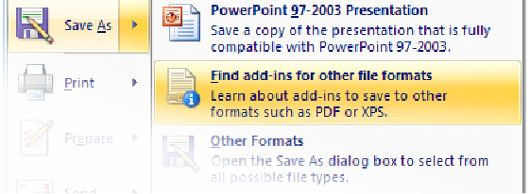
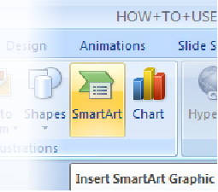
More New Features
Save as PDF - you can now share your presentation email for editing or fast printouts at a decreased file size.
Smart Art - make easy and useful diagrams, categorized charts, flow charts with many more selections than the old version of PowerPoint.
“On the fly” previewing - Preview changes, animations, and features in real time.

Slide 5
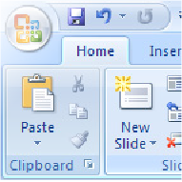
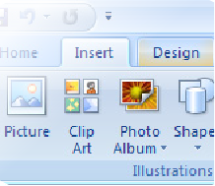
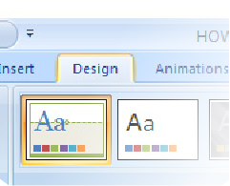
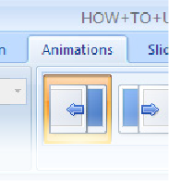
Tab Functions
Home- formatting, editing, and layout
Insert- shapes, more slides, tables, text, media clip
Design- themes, background colors, arrange objects
Animations- movement to slides or objects

Slide 6
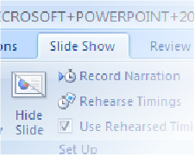
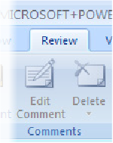
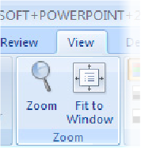
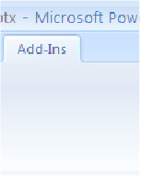
Tab Functions Continued
Slide Show- resolution, preview, custom
Review- spell check, translate text
View- to show different views of your slide
Add-Ins- show slides and record timings

Slide 7
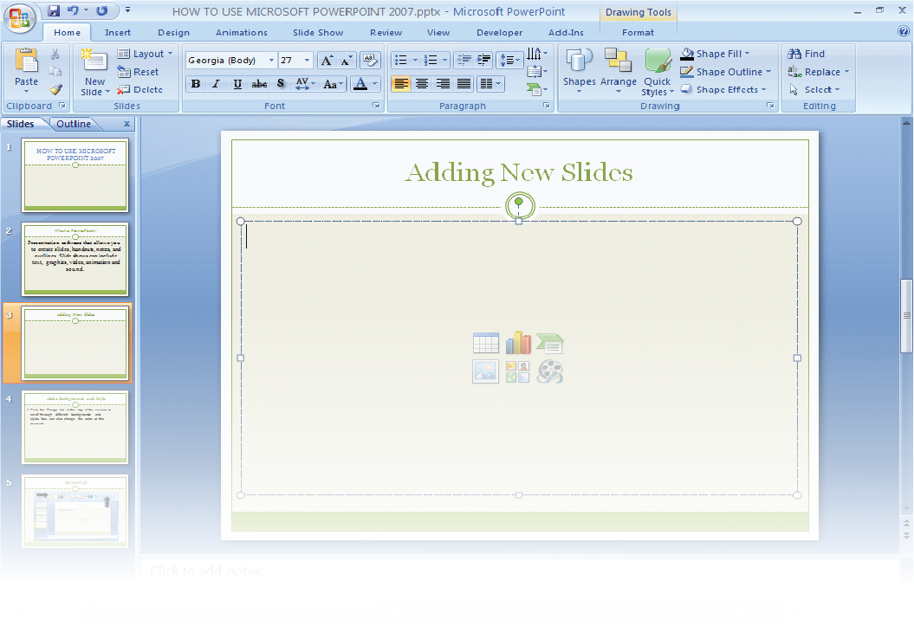
Adding and Deleting Slides
You can add a new slide by clicking on the “new slide” icon or by clicking enter below the slide you just finished. To the right of the “new slide” icon you can delete your slide.
You can add a new slide by clicking on the “new slide” icon or by clicking enter below the slide you just finished. To the right of the “new slide” icon you can delete your slide.

Slide 8
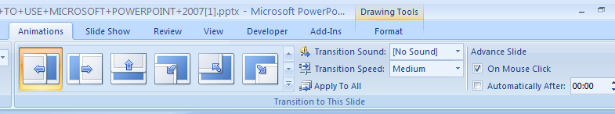
Turn Off “Advance Slide-On Mouse Click”
1
1
This will allow you to prevent advancing the slide when you click the mouse button.
2
Make sure you click on the tab that reads apply to all.
2

Slide 9
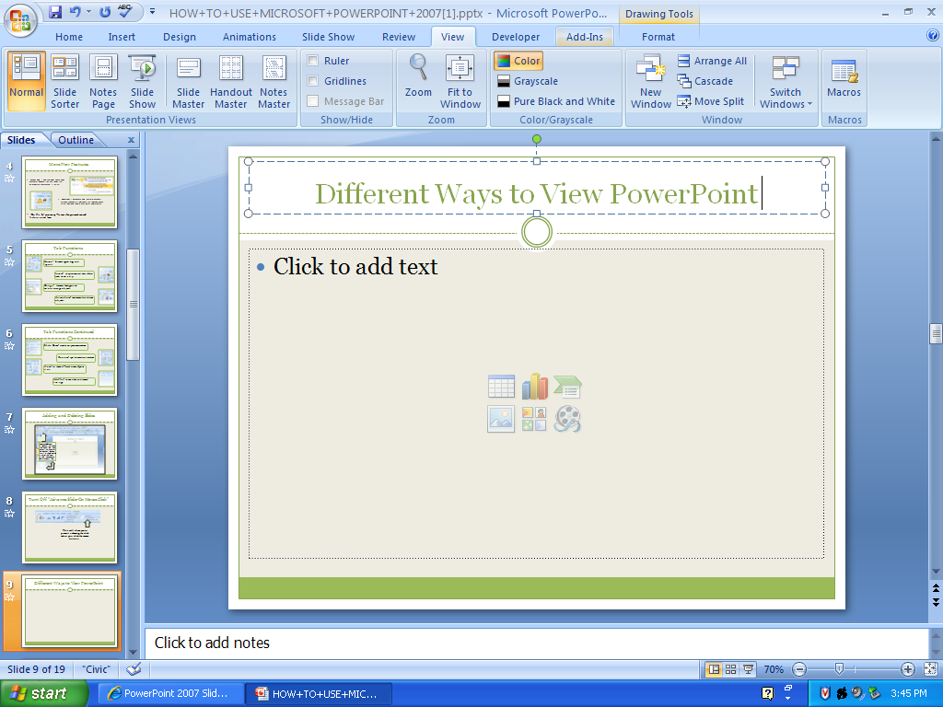
Different Ways to View PowerPoint
Allows you to print out your PowerPoint presentation in various ways . This is great for handouts that you and your audience can use to follow along .
To access the different slide views, click on the view ribbon at the top of the screen. On the left end of the view ribbon you will see the different choices to view your slide.

Slide 10
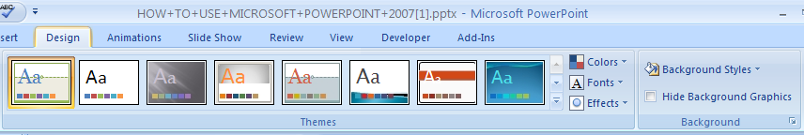
Backgrounds, Style, Fonts, Colors
Go to the Design tab at the top of the screen to scroll through different backgrounds and styles.
2
3
1
1. Click on themes and go to the color tab to change the color of the theme.
2.You can also change the font and add some fun effects.
3. Allows you to change Background Styles and Hide Background Graphics.

Slide 11
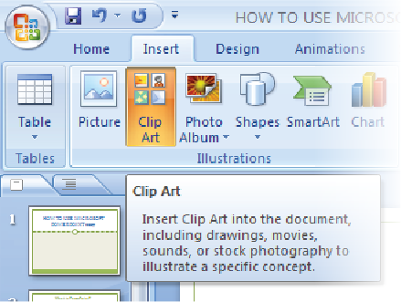
Inserting Clip Art
1. Click Insert Tab
2. Select Clip Art
3. Choose

Slide 12
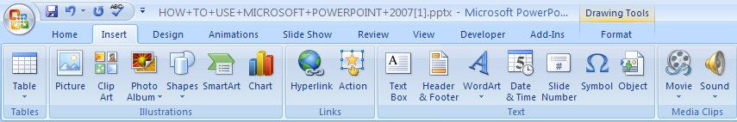
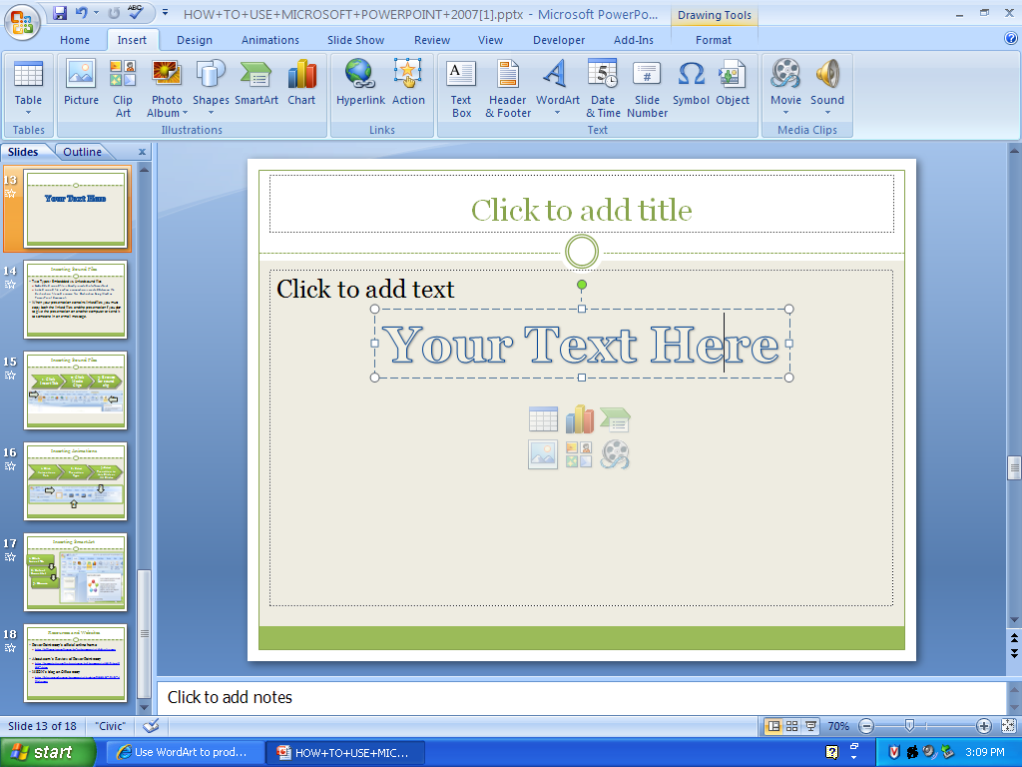
Using WordArt
Go to the Insert label on your ribbon and double click on the WordArt tab. Click on the design you would like and it should automatically take you to the Drawing Tools Format tab.
In the Edit WordArt text dialog box, type you text and select the desired font and size.

Slide 13
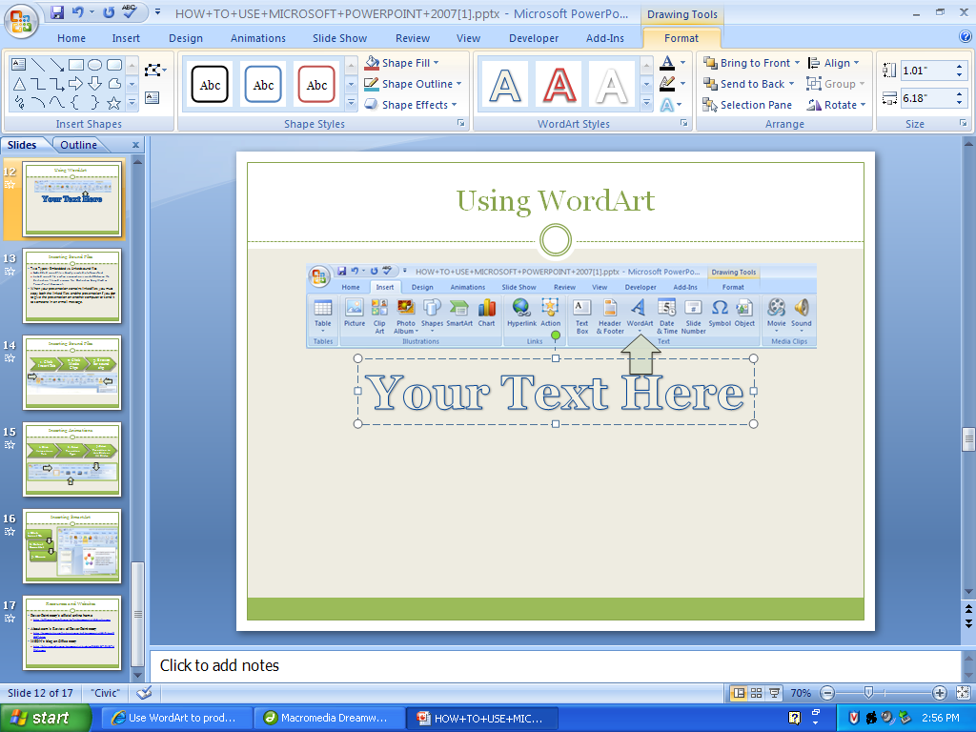
Using WordArt Continued….
You can select different shape styles, insert shapes, and arrange your text. To the right and at the bottom of WordArt Styles area you can change your text by adding an effect like this one.

Slide 14
Inserting Sound Files
Two Types: Embedded vs. Linked sound files
Embedded sound file is directly inserted into PowerPoint
Linked sound file is when a connection is created between the destination file and a source file. Destination being Word or PowerPoint document.
When your presentation contains linked files, you must copy both the linked files and the presentation if you plan to give the presentation on another computer or send it to someone in an e-mail message.

Slide 15
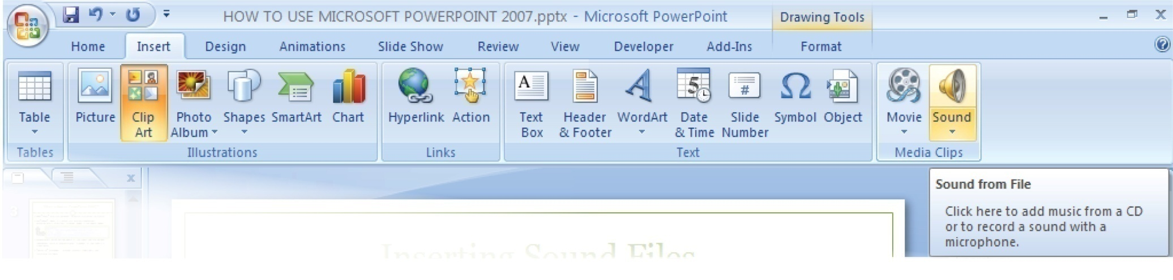
Inserting Sound Files
1. Click Insert Tab
2. Click Media Clips
3. Browse for sound clip
1.
2.

Slide 16
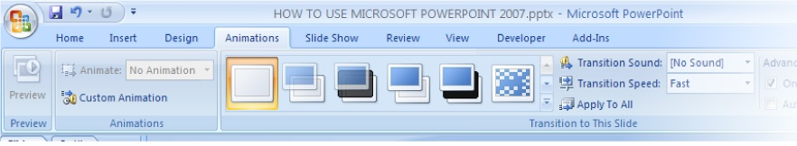
Inserting Animations
1. Click Animations Tab
2. Select Transition Type
3.Select Transition to this Slide or All Slides
3.
1.
2.

Slide 17
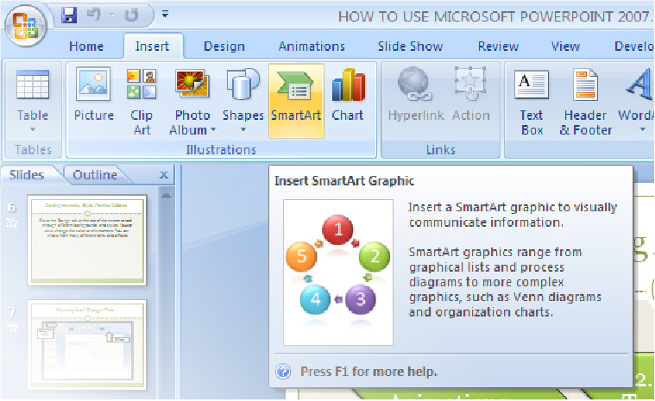
Inserting SmartArt
1. Click Insert Tab
2. Select SmartArt
3. Choose

Slide 18
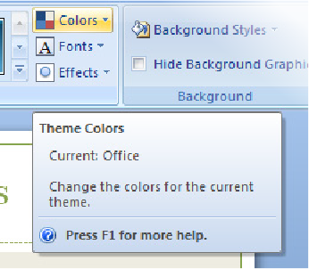
Editing Hyperlinks
Select the Design Tab
2. Select the Colors Tab

Slide 19
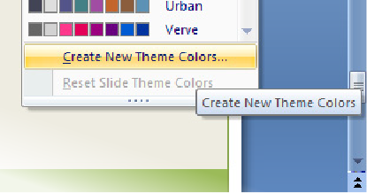
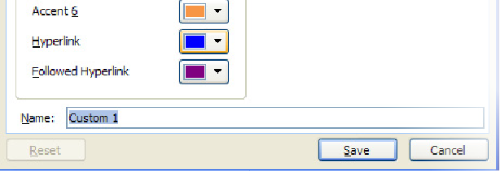
Editing Hyperlinks Continued
3. Select Create New Theme Colors
4. Edit the Followed Hyperlink

Slide 20
Resources and Websites
PowerPoint 2007’s official online home
http://office.microsoft.com/en-us/powerpoint/default.aspx
About.com’s Review of PowerPoint 2007
http://presentationsoft.about.com/od/powerpoint101/fr/ppt2007.htm
MSDN’s blog on Office 2007
http://blogs.msdn.com/powerpoint/archive/2006/07/21/674214.aspx

